Slide 1
RESOURCES REQUIRED
Paper
Something to write with

Slide 2
HOW TO
REVISE
SESSION 3 - DUAL-CODING
TIPS AND TRICKS TO HELP YOU LEARN HOW TO REVISE

Slide 3
PRAYER
Dear Lord,
Give me insight that I might understand what I am studying ,
and help me to remember it when the time comes.
Above all, I thank you for the ability to be able to study
and for the many gifts and talents you have given me.
Help me always to use them in such a way
that they honour you and do justice to myself.
Amen
St. Gregory
Pray for us

Slide 4

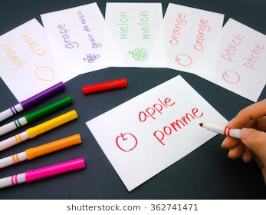


PASSIVE VS ACTIVE
Reading notes and highlighting key information make us FEEL like we’re doing revision BUT it requires very little brain power! We say it is PASSIVE.
In order to remember things long term, we need to DO something more ACTIVE.

Slide 5
EXAMPLES OF ACTIVE REVISION TECHNIQUES
Mind Maps
Flash Cards
Dual-Coding

Slide 6
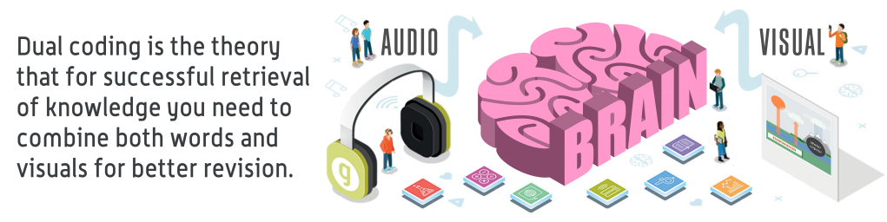
THIS WEEK’S FOCUS – DUAL-CODING
What is Dual-Coding?
Sounds a bit fancy, eh?
Well, we can often remember things more easily if we can link the WORDS we are learning to PICTURES.
How do most of us learn the alphabet? With the help of pictures!

Slide 7


Slide 8
How do we do it?
Method 1:
Turn your revision notes into pictures. You do not have to be a fantastic artist to do this! Simple line drawings with just one or two colours are the best - they don’t overload your brain!

Slide 9
Example 1
Biotic and Abiotic Factors
Bio means ‘life’. Biotic Factors are parts of an ecosystem that are ALIVE. For example animals, plants, bacteria
Abiotic means parts of an ecosystem that are NOT alive; the A at the beginnig of the word means ‘without’. For example temperature, rainfall, wind speed/direction
You have 3 minutes to complete a small diagram or picture that shows what Biotic and Abiotic factors are - give examples…… GO!

Slide 10
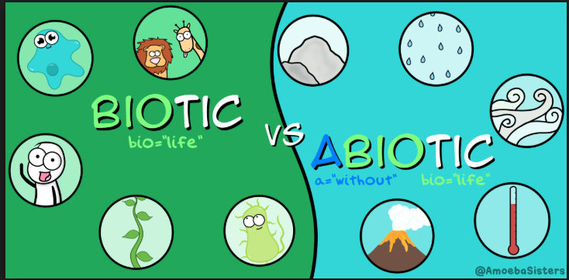
Example 1

Slide 11
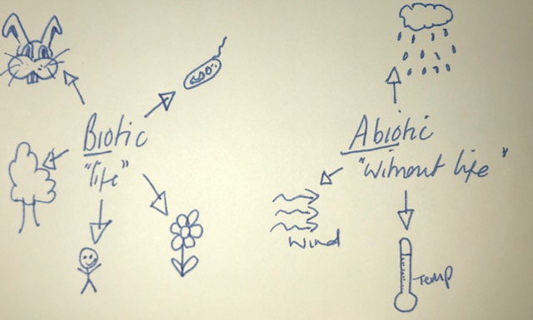
...or more simply

Slide 12
How do we do it?
Method 2:
From a picture or diagram in your notes, write down everything you can remember about that image. Keep your sentences short!

Slide 13
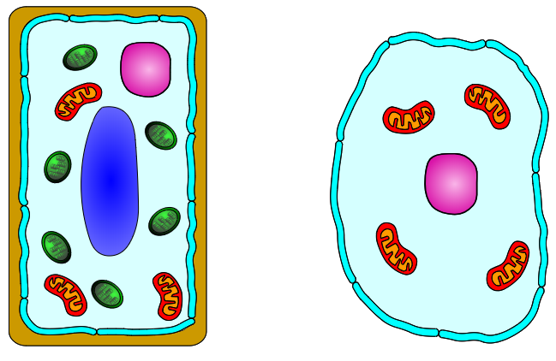
Example 2
What are these? You would
have learnt about them in Science!
You have 2 minutes to name them and as many of the parts as possible….GO!

Slide 14
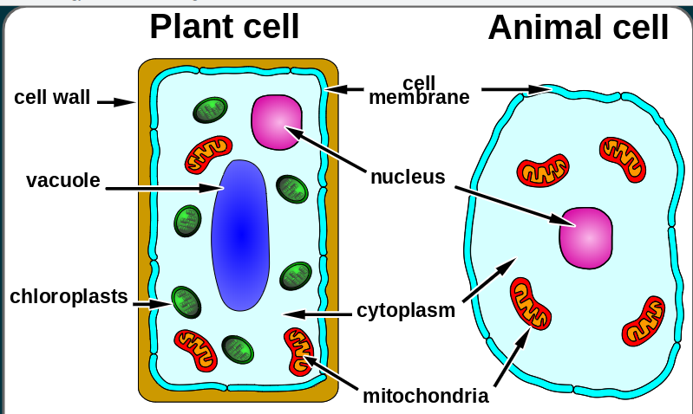
Example 2

Slide 15

YOUR TURN...
You have been taught about the Catholic
Mass in RE lessons.
Could you try to revise this topic by drawing pictures to show what happens in a Catholic Mass? Stick people are perfect - don’t worry about how artistic you are!
You have 5 minutes…. GO!

