Slide 1
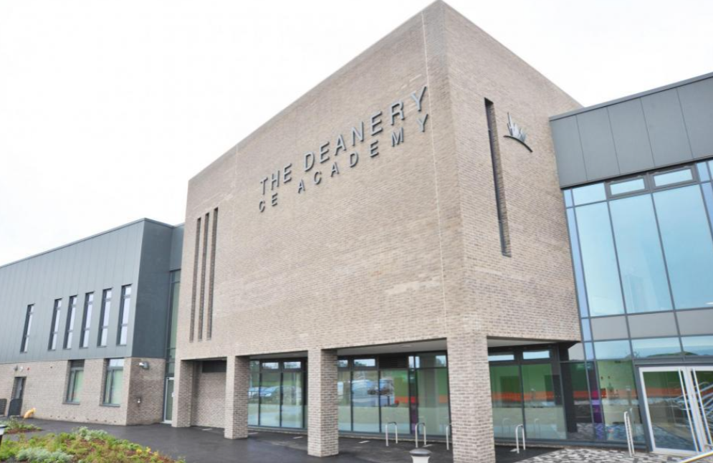

Welcome to The Deanery C of E Academy
Year 6 Induction 2026

Slide 2
The Senior Leadership Team
Mr Young – Executive Principal
Mr McDonald – Vice Principal (Curriculum)
Ms Connors – Vice Principal (Pastoral) SENDco
Ms Parry – Assistant Principal – Behaviour for Learning, Culture & Character
Ms Luckman– Assistant Principal – Designated Safeguarding Lead
Mrs Scotford – Assistant Principal – KS4 Raising Standards; Head of English
Mrs Matthews – Assistant Principal – Enrichment; Head of Performing Arts

Slide 3
Outstanding Academic Achievement
This summer, our students celebrated excellent GCSE results. The headline figures below for our core subjects are testament to the hard work of our students, the dedication of our staff, and the supportive environment we foster.
•71% of students achieved Grade 4 or above in both English and Maths, a 25% year-on-year improvement and 5% above National Average.
•50% of students achieved Grade 5 or above in both English and Maths, marking a 17% increase from the previous year and 6% above National Average.
 | 7+ % |  | 5+ % |  | 4+ %
Subject | Deanery | National | Deanery | National | Deanery | National
English Lang | 27 | 19 | 65 | 54 | 78 | 70
English Lit | 18 | 20 | 65 | 58 | 78 | 74
Maths | 15 | 21 | 54 | 52 | 74 | 72
Science (2X) |  |  | 57 | 46 | 74 | 64

Slide 4

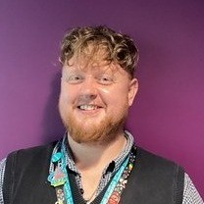

The Pastoral Team for Year 7
Ms Parry
(Assistant Headteacher)
Mr Cameron-Larelle
(Head of Year)
Mr Marriner
(Assistant Head of Year)
There will also be a team of 3 tutors who will be there to support the Year 7 cohort, as well as our safeguarding team.

Slide 5
Induction days
Getting to know each other.
Finding their way around the school.
Meeting the staff and students.
Feeling at ease.
All students are in a group. This is not their tutor group but will relate to their house next year.
They all have a folder to keep all their work in for the 3 days. They can bring this home and show you what they’ve been doing.

Slide 6
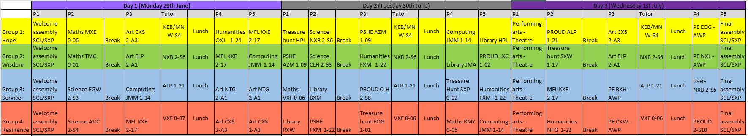
Induction days - timetable
Students will have a PE session on Wednesday and can come into school in their primary PE kits for that day.

Slide 7
Behaviour, Culture and Ethos

Slide 8
The School Day
The school day requires pupils to register with their tutor for the start of the school day at 8.45am.
We will expect pupils to arrive by 8.35am. This provides a crisp start to the day.
The breaks between lessons provide ‘take up time’ for teachers to deal with any behaviour for learning matters from the preceding lesson, and also helps pupils remain focused throughout the day. It allows students to have time to move between lessons and arrive for a punctual start.

Slide 9
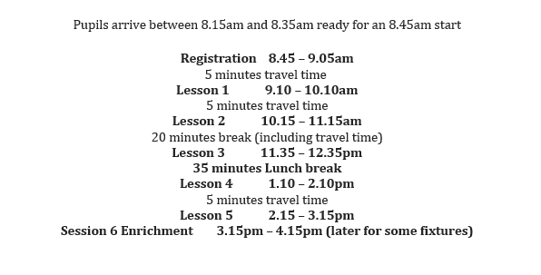
The School Day

Slide 10

School Culture

Slide 11
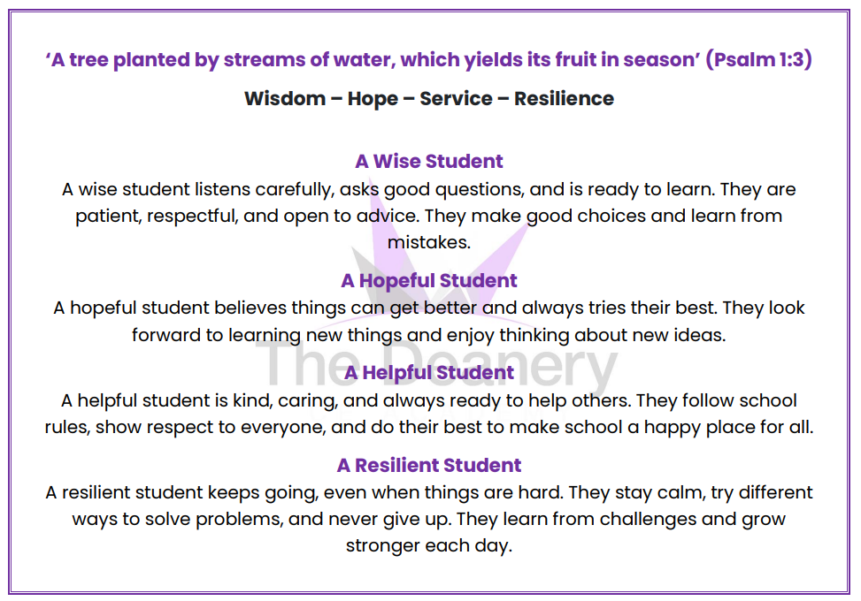

Slide 12
Ethos
There is an emphasis on building a strong academic ethos.
All pupils will be expected to work hard and behave respectfully in order to fulfil their potential.
Pupils will be expected to take pride in both the content and presentation of their work and the positive attributes we want to develop in our learners will be made clear from the outset.
Pupils’ academic performance will be supported by the pastoral system which will deal with any issues that might otherwise be a barrier to effective learning.

Slide 13
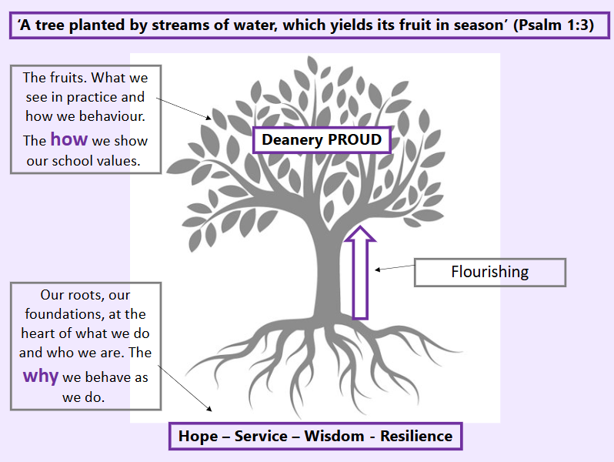

Slide 14
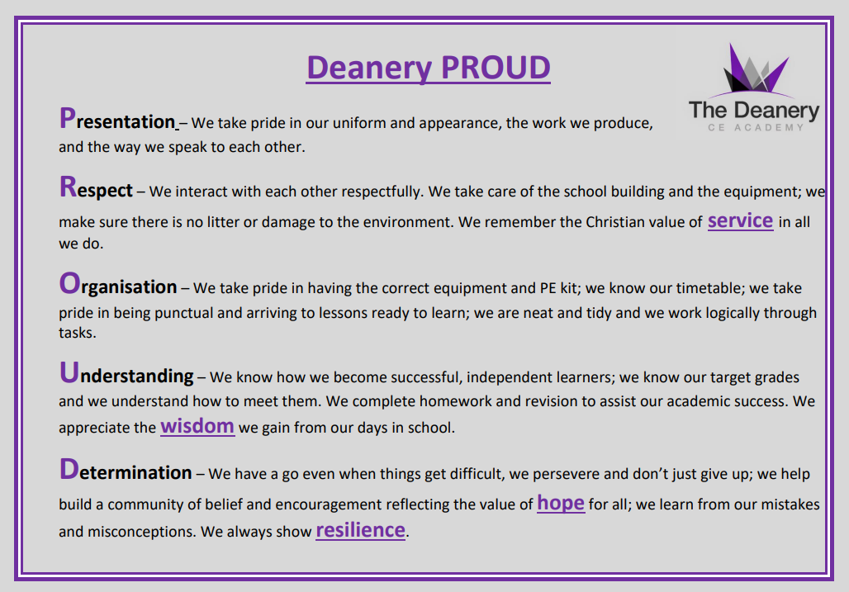

Slide 15
Uniform
The Deanery uniform supports the ethos and the academic values of the school. There is a high expectation that pupils will be dressed appropriately in the uniform. Any pupil not following the uniform rules will be challenged. Please ensure uniform is labelled with your child’s full name.
The uniform consists of:
Blazer
Grey straight legged trousers (no skinny trousers or leggings) or Grey tailored shorts
School skirt (worn at a suitable length)
White shirt (tucked in)
School tie
Purple jumper (optional)
Black shoes – not trainers. No logos.
One pair of stud earrings
No nose stud (or clear or covered)
Subtle make-up, no nail varnish or false nails. No false eyelashes.
No white/grey socks over tights

Slide 16

Equipment
It is important that students come to school ready to learn. This includes having the correct equipment with them every day
Black or blue Pen
Purple pen
Pencil
Ruler
Rubber
Sharpener
Scientific Calculator
Compass
Protractor
Whiteboard pen
Glue stick
Colouring pencils
Reading books
https://www.casio.com/uk/scientific-calculators/product.FX-83GTCW-W/

Slide 17

Tutor Programme
There is a tutor programme which indicates what must be covered during each tutor time. The programme will include:
Uniform checks
Equipment checks
Rewards and Consequences checks
Collective worship
Assembly
Reading program

Slide 18
Attendance
Good attendance enables your child to engage in learning and fulfil their potential. Our expectation is that pupils attend school everyday.
If your child is ill, please notify the school as soon as possible. Genuine absence will be identified as authorised.
Unauthorised absence affects your child’s attendance record and may lead to a fine from the Local Authority.
Leave of Absence such as holidays or participation in sport or performances must be requested. Holidays are not allowed to be taken during term time and therefore will be identified as unauthorised.

Slide 19

Attendance
Why Attendance Matters in Year 7
Supports a successful transition to secondary school.
Helps students make strong academic progress.
Builds positive routines and habits.
Encourages friendships and a sense of belonging.
Improves confidence and engagement in lessons.
Prepares students for future education and employment.
Why We Aim for 96% Attendance
Missing lessons can lead to gaps in learning and lower achievement.
Regular attendance helps students keep up with their peers and reach their potential.
HOPE SERVICE RESILIENCE WISDOM

Slide 20
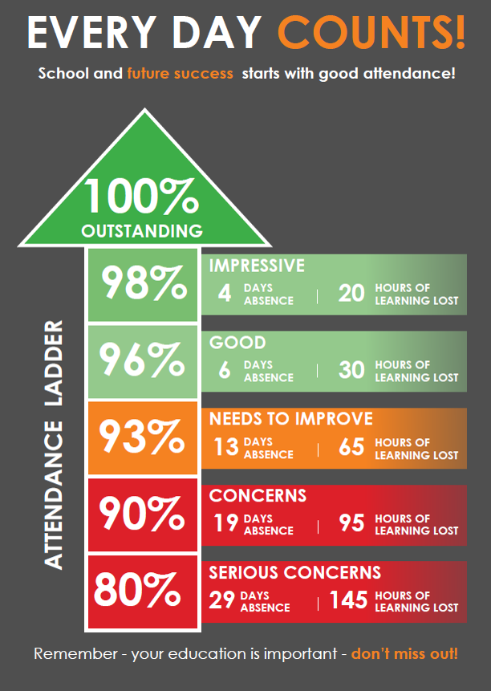

Slide 21
Behaviour for Learning – Expectations and Policy
A high expectation of behaviour will be made clear to all stakeholders from the outset. This is outlined in the behaviour for learning policy.
All staff are responsible for behaviour across the school.
To achieve consistency in approach to positive behaviour and challenge unacceptable behaviour, our staff have all read and follow the Behaviour for Learning Policy.
The Behaviour for Learning Policy is one of a number of policies available to parents on the school website. Staff and pupils will follow the rewards and consequences system as displayed in class and around the school.

Slide 22
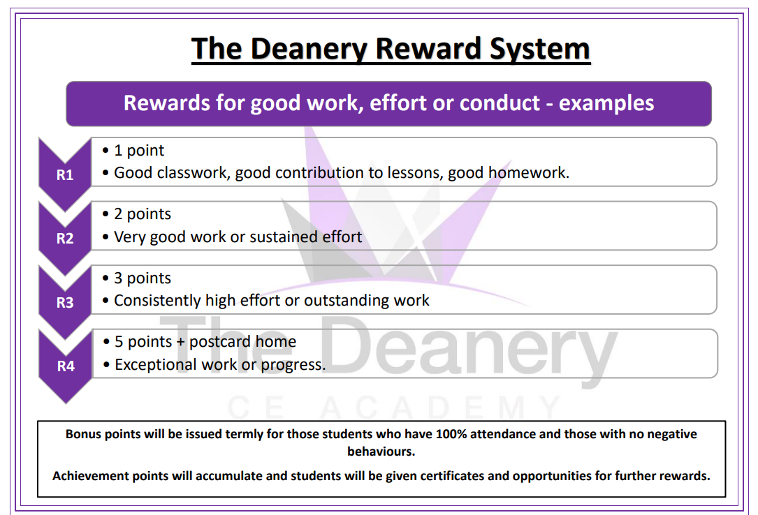

Slide 23
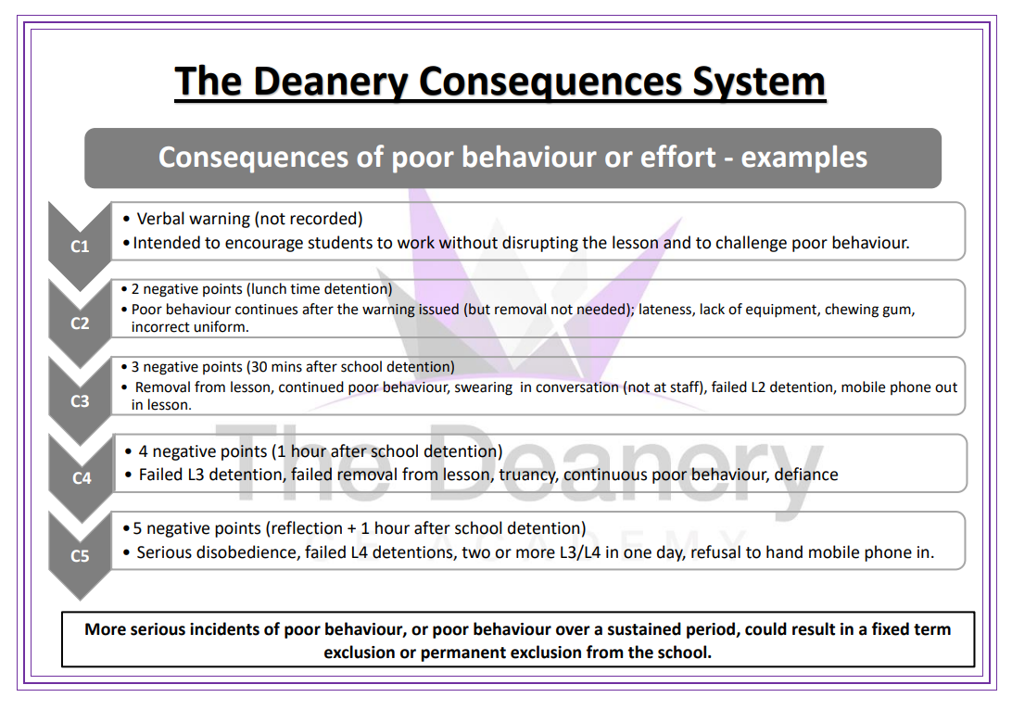

Slide 24
Home School Communication
Your child’s tutor will be your first point of contact for pastoral or attendance concerns. If a problem persists or is more serious, it may then be passed upwards to the Head of Year.
For queries or concerns regarding a particular subject or lesson parents should contact the classroom teacher in the first instance. If, following this, you still have concerns please contact the Curriculum Leader for that subject. We aim to respond to your concerns as soon as possible, but within 48 working hours. You may contact the school by phone, e-mail or letter.
If you would like to discuss something face to face please contact reception to arrange a meeting. Please do not turn up to the school as it is highly unlikely that the person you most need to see is available at that time. Ringing ahead to make an appointment can avoid a wasted trip and the need for a return visit.
Detentions – we would ask that you work with the school and trust the professionalism of the staff when they issue detentions. You will be able to monitor your child’s behaviour and attendance on Arbor.

Slide 25
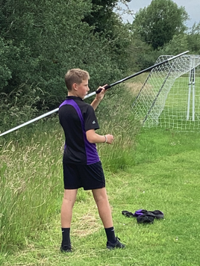
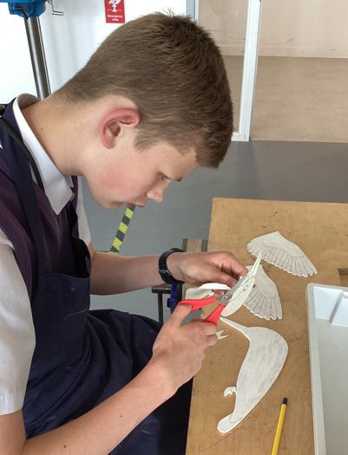
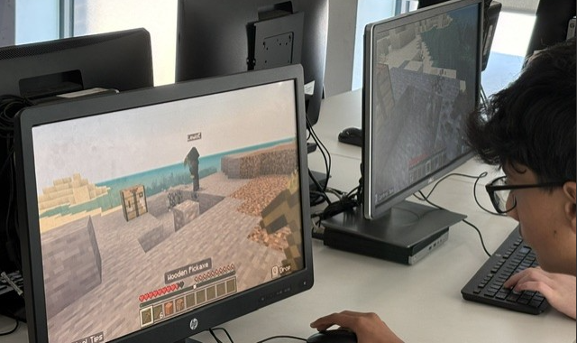
Enrichment
Develops new skills and interests by giving students opportunities to explore activities beyond the classroom, such as sports, music, coding, or art.
Builds confidence and teamwork by encouraging students to work with others, solve problems, and develop communication and leadership skills.
Our recent student voice survey found that students attend enrichment clubs because they:
Have fun and enjoy taking part in activities they are interested in.
Spend time with friends and build positive relationships.
Learn new skills that develop their confidence and broaden their experiences.
Keep active, supporting their physical and mental wellbeing.
HOPE SERVICE RESILIENCE WISDOM

Slide 26
Teaching and Learning at
The Deanery

Slide 27
Key Stage 3 Curriculum Model
At the Deanery we operate a two-week timetable.
The Core Curriculum:
Maths | English | Science | RE | PE | PSHE
7 | 7 | 6 | 3 | 4 | 2
The KS3 Curriculum:
Geography | History | Languages | Drama | Music | Art | Computing | DT
2 | 3 | 4 | 2 | 2 | 2 | 2 | 4

Slide 28
Teaching and Learning
Pupil engagement with school reflects the quality of teaching and learning they experience.
Non-negotiables in lessons.
  Do Now and Exit Ticket
  Mini whiteboards (mini-whiteboard pen)
  Self and Peer Assessment (purple pen)
  Independent practice and Silent Solo
  Checking for Understanding via Cold Call, Show Call, Turn and Talk and Silent Solo.
  Written Feedback via WWW, HTI and MAC

Slide 29
Homework
Homework is set on-line through Arbor
The Deanery CE Academy Homework Timetable
The table below indicates the day of each week that Homework will be set for each subject.
 | Monday | Tuesday | Wednesday | Thursday | Friday
KS3 | Humanities (Geography, History or RE) | Science | Maths | English | Performing Arts / MFL
*Creative Arts (DT, Food, Art) - will set homework in a more ad/hoc manner to suit the needs of the course.
-A weekly homework club will be running next year for students to support with homework completion.
-Failure to submit homework will lead to a 30-minute afterschool detention (to support with the completion of the homework).

Slide 30
Assessment and Reporting
All students will be regularly assessed throughout their curriculum lessons.
Students will receive feedback on these assessments via WWW, HTI and MAC
Reports will go home to parents three times a year. These will include information on Attitude to Learning, Behaviour for Learning and a statement on how they are progressing in each subject.

Slide 31
Parent Evenings and Consultation day
A Tutor Consultation evening will take place during Term 1 (20th October 2026). This is an opportunity for parents to meet with their child’s tutor remotely to discuss how they have settled into life at The Deanery.
There will also be a Year 7 Subject Consultation (7th January 2027) evening where parents will have the opportunity to meet their child’s individual subject teachers to discuss their progress. This will happen in person at school.

Slide 32
Thank you for listening.
We look forward to working with you and your child during their time at The Deanery C E Academy.

