Slide 1
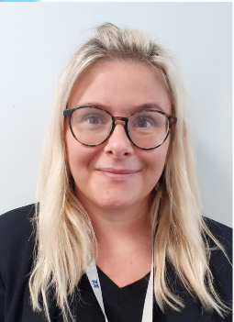
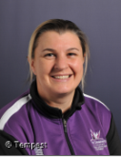
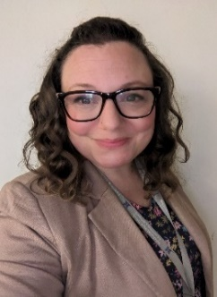
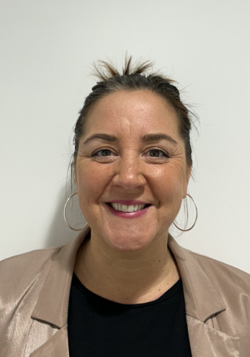
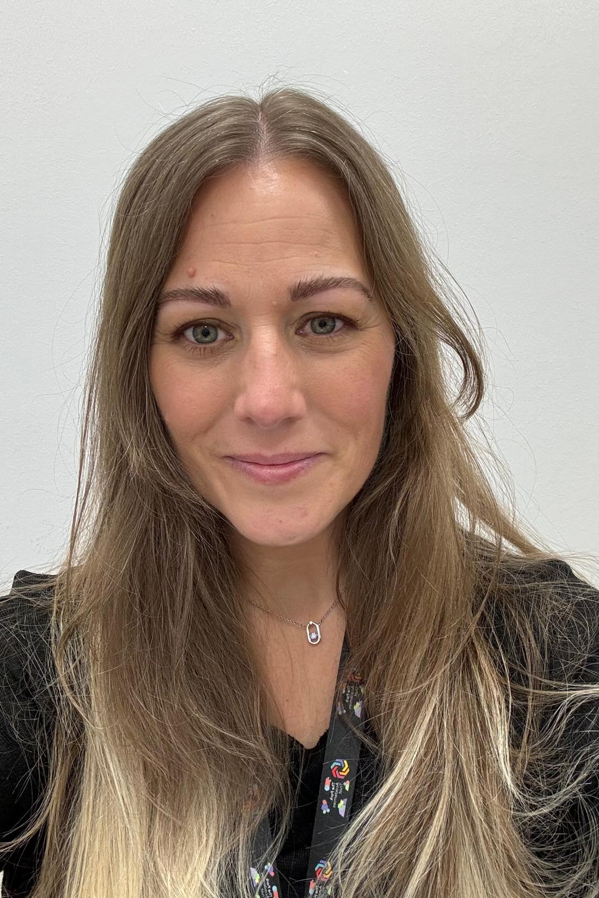
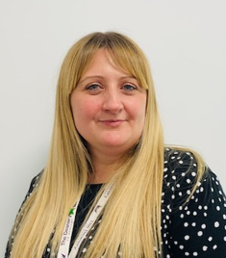
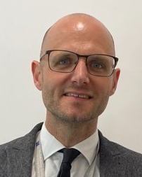
The Deanery Safeguarding Team
Miss Luckman
Designated Safeguarding Lead
Exploitation and County Lines
Prevent
Harmful Sexual Behaviour
Child Protection
Domestic Abuse and Police Liaison
Online safety
Filtering and Monitoring
Miss Connors
Deputy Headteacher – Pastoral
FGM
Radicalisation and Prevent
Ms Parry
Assistant Headteacher – Pastoral
Mental Health
Online Safety - Securus alerts
Mrs Woodfield
Attendance Officer
Attendance
Child in Need
Mrs Matthews
DDSL and Student Support
Young Carers
Self-harm
Child in Need
Mrs Buckley
HLTA and DDSL
Trauma Informed
Knife Crime Awareness
Mr McDonald
Deputy Headteacher – Curriculum

